Slide 1

Statistical Fundamentals:
Using Microsoft Excel for Univariate and Bivariate Analysis
Alfred P. Rovai
Univariate Normality
PowerPoint Prepared by
Alfred P. Rovai
Microsoft® Excel® Screen Prints Courtesy of Microsoft Corporation.

Slide 2
Univariate Normality
Normality refers to the shape of a variable’s distribution.
  symmetrical and shaped like a bell-curve.
Parametric tests assume normality
  The variable or variables of interest are approximately normally distributed.
The perfectly normal univariate distribution has standardized kurtosis and skewness statistics equal to zero and mean = mode = median
The assumption of normality does not require a perfectly normal shape.
  The standard coefficients of kurtosis and skewness can each vary, as long as they are > –2 or and < +2.
  The mean, mode, and median do not need to be equal.
  Many parametric procedures, e.g., one-way ANOVA, are robust in the face of light to moderate departures from normality.

Slide 3
Procedures
Several tools are available in Excel to evaluate univariate normality
Create a histogram to observe the shape of the distribution and to conduct a preliminary evaluation of normality
Calculate standard coefficients of skewness and kurtosis to determine if the shape of the distribution differs from that of a normal distribution
Calculate z-scores to identify the presence of extreme outliers
Use the Kolmogorov-Smirnov Test to determine if the data come from a population with a normal distribution

Slide 4
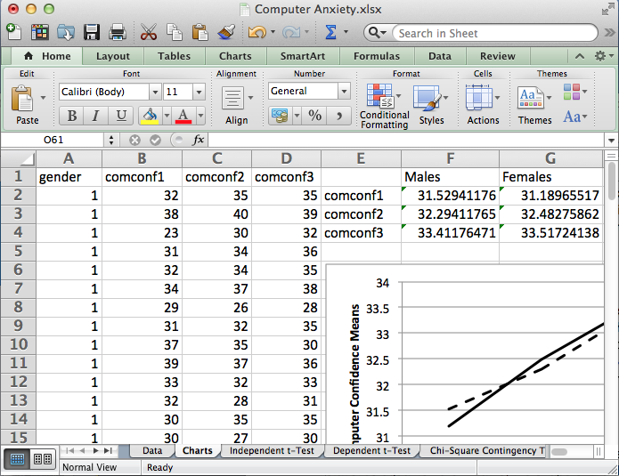
Open the dataset Computer Anxiety.xlsx.
Click the worksheet Charts tab (at the bottom of the worksheet).
File available at http://www.watertreepress.com/stats
TASK
Evaluate computer confidence posttest (comconf2) for univariate normality.

Slide 5
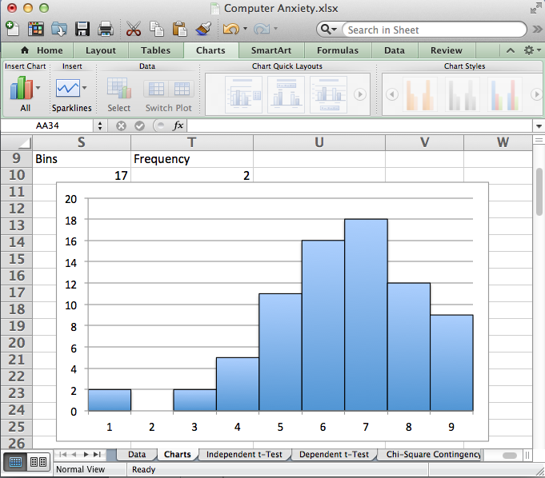
Histogram
Create a histogram that displays computer confidence posttest in accordance with the procedures described in the textbook and the Charts Power Point presentation. It reveals a non-symmetrical, negatively-skewed shape.
The issue now is to determine whether or not univariate normality is tenable. That is, to determine the extent of the deviations from normality.

Slide 6
Skewness
Skewness is based on the third moment of the distribution, or the sum of cubic deviations from the mean. It measures deviations from perfect symmetry.
Positive skewness indicates a distribution with a heavier positive (right-hand) tail than a symmetrical distribution.
Negative skewness indicates a distribution with a heavier negative tail.
Excel function:
SKEW(number1,number2,...). Returns the skewness statistic of a distribution.
The standard error of skewness (SES) is a measure of the accuracy of the skewness coefficient and is equal to the standard deviation of the sampling distribution of the statistic.
Normal distributions produce a skewness statistic of approximately zero. The skewness coefficient divided by its standard error can be used as a test of normality. That is, one can reject normality if this ratio is less than –2 or greater than +2.

Slide 7
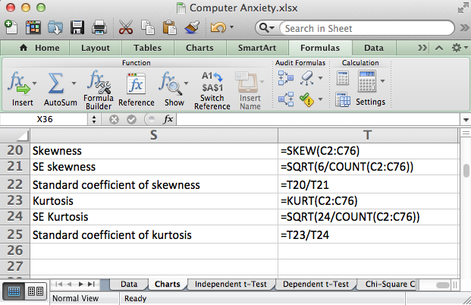
Enter the formulas displayed in cells T20:T22 to calculate the skewness coefficient, the standard error of skewness, and the standard coefficient of skewness.

Slide 8
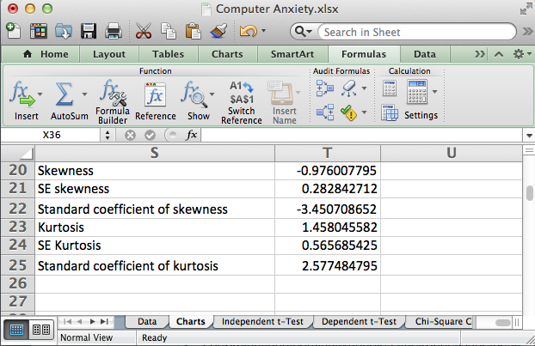
The standard coefficient of skewness for the computer confidence posttest data indicates a non-normal, negatively-skewed distribution.

Slide 9
Kurtosis
Kurtosis is derived from the fourth moment (i.e., the sum of quartic deviations). It captures the heaviness or weight of the tails relative to the center of the distribution. Kurtosis measures heavy-tailedness or light-tailedness relative to the normal distribution.
A heavy-tailed distribution has more values in the tails (away from the center of the distribution) than the normal distribution, and will have a negative kurtosis.
A light-tailed distribution has more values in the center (away from the tails of the distribution) than the normal distribution, and will have a positive kurtosis.
Excel function:
KURT(number1,number2,...). Returns the kurtosis statistic of a distribution.
The standard error of kurtosis is a measure of the accuracy of the kurtosis coefficient and is equal to the standard deviation of the sampling distribution of the statistic.
Normal distributions produce a kurtosis statistic of approximately zero. The kurtosis coefficient divided by its standard error can be used as a test of normality. That is, one can reject normality if this ratio is less than –2 or greater than +2.

Slide 10
Enter the formulas displayed in cells T23:T25 to calculate the kurtosis coefficient, the standard error of kurtosis, and the standard coefficient of kurtosis.

Slide 11
The standard coefficient of kurtosis for the computer confidence posttest data indicates a non-normal, leptokurtic (peaked shape as opposed to flat shaped) distribution.

Slide 12
Extreme Outliers
Outliers are anomalous observations that have extreme values with respect to a single variable.
Reasons for outliers vary from data collection or data entry errors to valid but unusual measurements.
Normal distributions do not include extreme outliers.
It is common to define extreme univariate outliers as cases that are more than three standard deviations above the mean of the variable or less than three standard deviations from the mean.

Slide 13
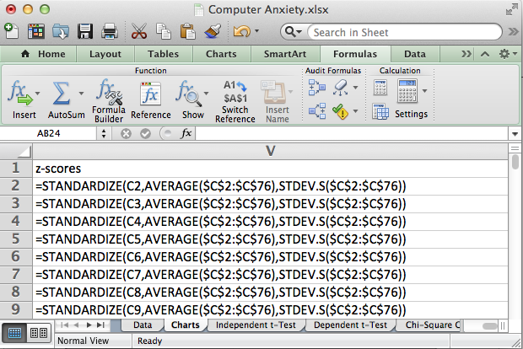
Calculate z-scores for variable computer confidence posttest. Enter the formula shown on the worksheet in cell V2. Then select cell V2, hold down the Shift key, and click on cell V76 in order to select the range V2:V76. Then use the Excel Edit menu and Fill Down to replicate the formula.

Slide 14
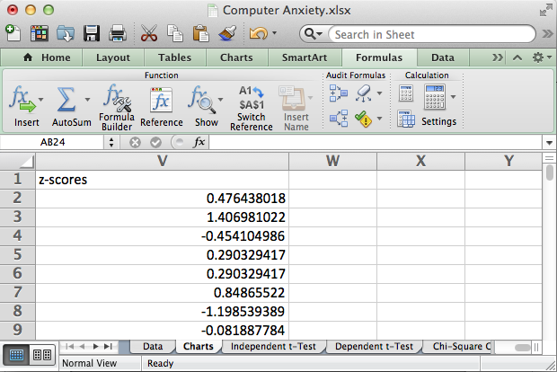
Extreme outliers have z-scores below – 2 and above +2.
Scan the z-scores to note the following extreme outliers:
Case 67: -3.06
Case 76: -3.43

Slide 15
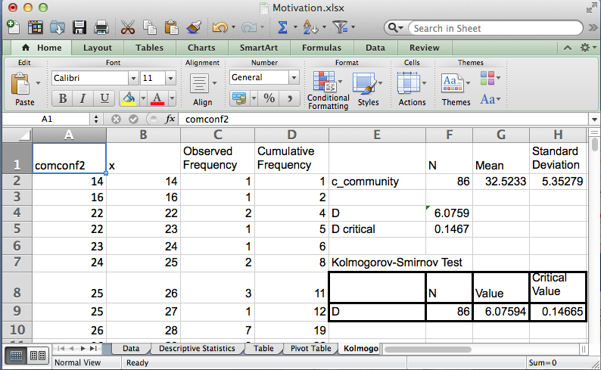
Kolmogorov-Smirnov Test
Conduct the Kolmogorov-Smirnov Test in accordance with the procedures described in the textbook in order to evaluate the following null hypothesis:
H_{o}: There is no difference between the distribution of computer confidence posttest data and a normal distribution.
Test results are significant since D > the critical value at the .05 significance level. Therefore, there is sufficient evidence to reject the null hypothesis and assume normality is not tenable.

Slide 16
Conclusion
Univariate normality is not tenable for posttest computer confidence
The histogram reveals a non-symmetrical negatively-skewed shape
The standard coefficient of skewness of -3.45 indicates a non-normal negatively-skewed distribution
The standard coefficient of kurtosis of 2.58 indicates a non-normal leptokurtic distribution
There are two low extreme outliers, z < 3
The Kolmogorov-Smirnov test results are statistically significant at the .05 level indicating a non-normal distribution

Slide 17
Univariate Normality
End of Presentation

